Slide 1
Chapter 4
SQL (Structured Query Language)
-Niraj K.C.

Slide 2
Table of Content
Background, Basic structure,
Set operation, aggregate functions, null values,
Nested sub queries, views,
Modification of database, joined relationship,
Data-definition Language

Slide 3
SQL???
SQL is Structured Query Language, which is a computer language for storing, manipulating and retrieving data stored in relational database.
SQL is the standard language for Relation Database System. All relational database management systems like MySQL, MS Access, Oracle, Sybase, Informix, postgres and SQL Server use SQL as standard database language.
Also, they are using different dialects/languages, such as:
MS SQL Server using T-SQL,
Oracle using PL/SQL,
MS Access version of SQL is called JET SQL (native format) etc

Slide 4
Why SQL?
Allows users to access data in relational database management systems.
Allows users to describe the data.
Allows users to define the data in database and manipulate that data.
Allows users to create and drop databases and tables
Allows users to create view, stored procedure, functions in a database.
Allows users to set permissions on tables, procedures and views

Slide 5
History
1970 Dr. E. F. "Ted" of IBM is known as the father of relational databases. He described a relational model for databases.
1974 Structured Query Language appeared.
1978 IBM worked to develop Codd's ideas and released a product named System/R.
1986 IBM developed the first prototype of relational database and standardized by ANSI.
The first relational database was released by Relational Software and its later becoming Oracle.

Slide 6
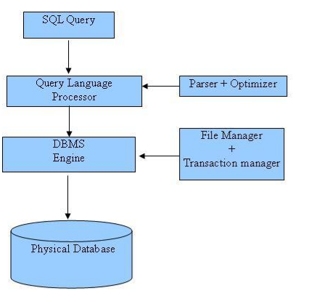
SQL Process/Architecture

Slide 7
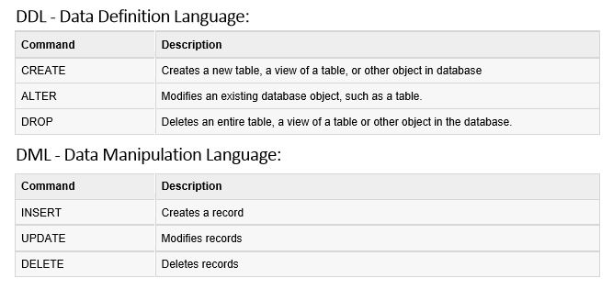
SQL Commands

Slide 8
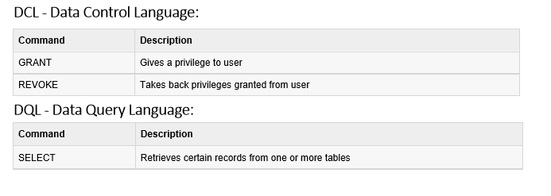

Slide 9
NULL value
A NULL value in a table is a value in a field that appears to be blank, which means a field with a NULL value is a field with no value.
It is very important to understand that a NULL value is different than a zero value or a field that contains spaces.
A field with a NULL value is one that has been left blank during record creation.

Slide 10
SQL Constraints
Constraints are the rules enforced on data columns on table.
Constraints are used to limit the type of data that can go into a table.
Constraints ensures the accuracy and reliability of the data in the database.
Constraints could be column level or table level,
Column level constraints are applied only to one column
Table level constraints are applied to the whole table.

Slide 11
Commonly Used Constraints available in SQL
NOT NULL Constraint: Ensures that a column cannot have NULL value.
DEFAULT Constraint: Provides a default value for a column when none is specified.
UNIQUE Constraint: Ensures that all values in a column are different.
PRIMARY Key: Uniquely identified each rows/records in a database table.
FOREIGN Key: Uniquely identified a rows/records in any another database table.
CHECK Constraint: The CHECK constraint ensures that all values in a column satisfy certain conditions.
INDEX: Use to create and retrieve data from the database very quickly.

Slide 12
Example 1:
For example, the following SQL creates a new table called CUSTOMERS and adds five columns, three of which, ID and NAME and AGE, specify not to accept NULLs:
CREATE TABLE CUSTOMERS(
ID INT NOT NULL,
NAME VARCHAR (20) NOT NULL,
AGE INT NOT NULL,
ADDRESS CHAR (25) ,
SALARY DECIMAL (18, 2),
PRIMARY KEY (ID)
);

Slide 13
If CUSTOMERS table has already been created, then to add a NOT NULL constraint to SALARY column in Oracle and MySQL, you would write a statement similar to the following:
ALTER TABLE CUSTOMERS
MODIFY SALARY DECIMAL (18, 2) NOT NULL;

Slide 14
Example 2
The following SQL creates a new table called CUSTOMERS and adds five columns. Here, SALARY column is set to 5000.00 by default, so in case INSERT INTO statement does not provide a value for this column. then by default this column would be set to 5000.00.
CREATE TABLE CUSTOMERS(
ID INT NOT NULL,
NAME VARCHAR (20) NOT NULL,
AGE INT NOT NULL,
ADDRESS CHAR (25) ,
SALARY DECIMAL (18, 2) DEFAULT 5000.00,
PRIMARY KEY (ID)
);
If CUSTOMERS table has already been created, then to add a DEFAULT constraint to SALARY column, you would write a statement similar to the following:
ALTER TABLE CUSTOMERS
MODIFY SALARY DECIMAL (18, 2) DEFAULT 5000.00;

Slide 15
Drop Default Constraint: To drop a DEFAULT constraint, use the following SQL:
ALTER TABLE CUSTOMERS
ALTER COLUMN SALARY DROP DEFAULT;
UNIQUE Constraint: The UNIQUE Constraint prevents two records from having identical values in a particular column.
In the CUSTOMERS table, for example, you might want to prevent two or more people from having identical age.

Slide 16
Example 3
For example, the following SQL creates a new table called CUSTOMERS and adds five columns. Here, AGE column is set to UNIQUE, so that you can not have two records with same age:
CREATE TABLE CUSTOMERS(
ID INT NOT NULL,
NAME VARCHAR (20) NOT NULL,
AGE INT NOT NULL,
ADDRESS CHAR (25) ,
SALARY DECIMAL (18, 2),
PRIMARY KEY (ID)
);

Slide 17
If CUSTOMERS table has already been created, then to add a UNIQUE constraint to AGE column, you would write a statement similar to the following:
ALTER TABLE CUSTOMERS
MODIFY AGE INT NOT NULL UNIQUE;
You can also use following syntax, which supports naming the constraint in multiple columns as well:
ALTER TABLE CUSTOMERS
ADD CONSTRAINT myUniqueConstraint UNIQUE(AGE, SALARY);

Slide 18
DROP a UNIQUE Constraint: To drop a UNIQUE constraint, use the following SQL:
ALTER TABLE CUSTOMERS
DROP CONSTRAINT myUniqueConstraint;
If you are using MySQL, then you can use the following syntax:
ALTER TABLE CUSTOMERS
DROP INDEX myUniqueConstraint;

Slide 19
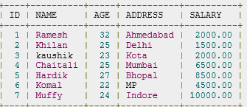
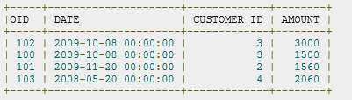
SQL Joins
SQL Joins clause is used to combine records from two or more tables in a database. A JOIN is a means for combining fields from two tables by using values common to each.
Consider the following two tables,
CUSTOMERS table Another table is ORDERS
Now, let us join these two tables in our SELECT statement as follows:
SQL> SELECT ID, NAME, AGE, AMOUNT FROM CUSTOMERS, ORDERS WHERE CUSTOMERS.ID = ORDERS.CUSTOMER_ID;

Slide 20


Slide 21
SQL Join Types
INNER JOIN: returns rows when there is a match in both tables.
LEFT JOIN: returns all rows from the left table, even if there are no matches in the right table.
RIGHT JOIN: returns all rows from the right table, even if there are no matches in the left table.
FULL JOIN: returns rows when there is a match in one of the tables.
CARTESIAN JOIN: returns the Cartesian product of the sets of records from the two or more joined tables.

Slide 22
INNER JOIN
The most frequently used and important of the joins is the INNER JOIN. They are also referred to as an EQUIJOIN.
The INNER JOIN creates a new result table by combining column values of two tables (table1 and table2) based upon the join-predicate.
The query compares each row of table1 with each row of table2 to find all pairs of rows which satisfy the join-predicate.
When the join-predicate is satisfied, column values for each matched pair of rows of A and B are combined into a result row.
Syntax: The basic syntax of INNER JOIN is as follows:
SELECT table1.column1, table2.column2... FROM table1 INNER JOIN table2 ON table1.common_filed = table2.common_field;

Slide 23
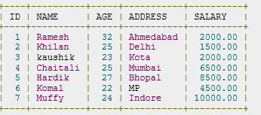
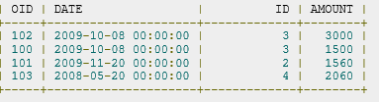
Example 4:
Consider the following two tables, (a) CUSTOMERS table is as follows
(b) Another table is ORDERS as follows:

Slide 24
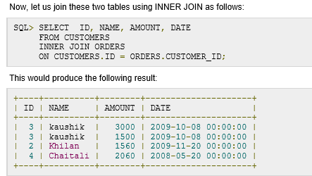

Slide 25
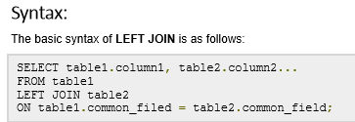
LEFT JOIN
The SQL LEFT JOIN returns all rows from the left table, even if there are no matches in the right table.
This means that if the ON clause matches 0 (zero) records in right table, the join will still return a row in the result, but with NULL in each column from right table.
This means that a left join returns all the values from the left table, plus matched values from the right table or NULL in case of no matching join predicate.

Slide 26
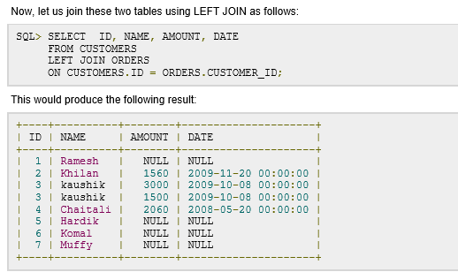

Slide 27
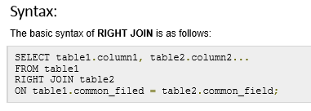
RIGHT JOIN
The SQL RIGHT JOIN returns all rows from the right table, even if there are no matches in the left table.
This means that if the ON clause matches 0 (zero) records in left table, the join will still return a row in the result, but with NULL in each column from left table.
This means that a right join returns all the values from the right table, plus matched values from the left table or NULL in case of no matching join predicate.

Slide 28
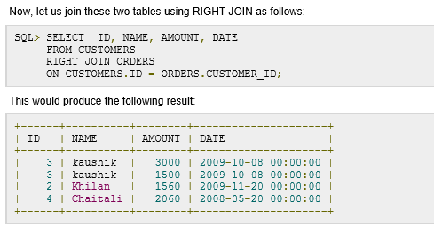

Slide 29
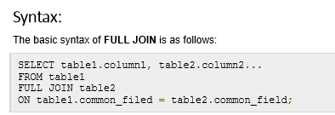
FULL JOIN
The SQL FULL JOIN combines the results of both left and right outer joins.
The joined table will contain all records from both tables, and fill in NULLs for missing matches on either side.

Slide 30
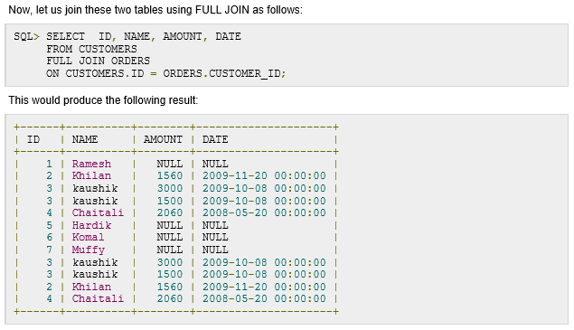

Slide 31
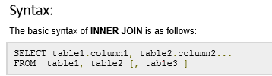
CARTESIAN JOIN
The CARTESIAN JOIN or CROSS JOIN returns the Cartesian product of the sets of records from the two or more joined tables.
Thus, it equates to an inner join where the join-condition always evaluates to True or where the join condition is absent from the statement.

Slide 32

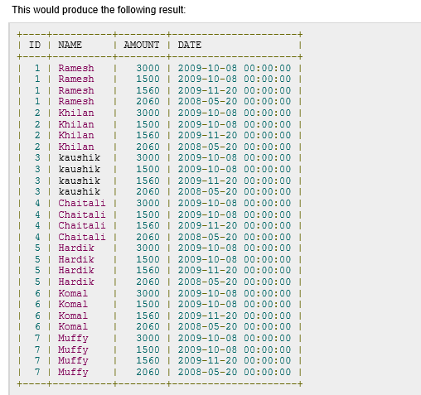

Slide 33
Set Operations
SQL supports few Set operations to be performed on table data to get meaningful results from data under different specials conditions.
Queries containing set operators are called compound queries.
Set operations :
Union
Union All
Intersect
Minus

Slide 34

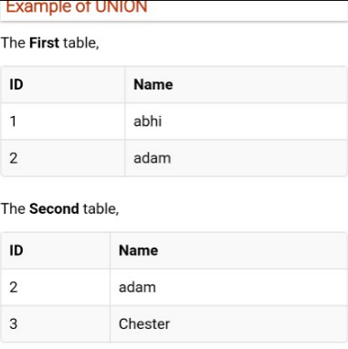
Union
Union combines results of two or more selected statements.
Eliminate duplicate rows from its result set.
All distinct rows selected by either query.
Numbers of columns and data type must be same in the both the tables.

Slide 35
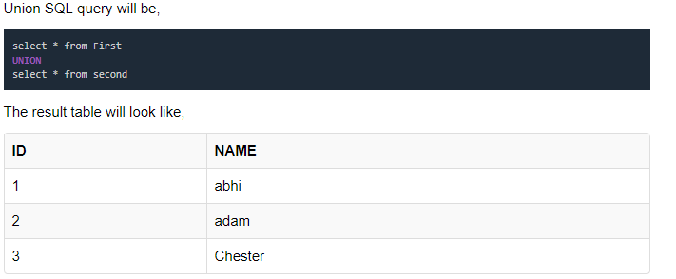

Slide 36
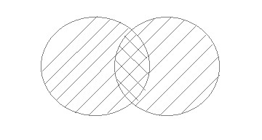
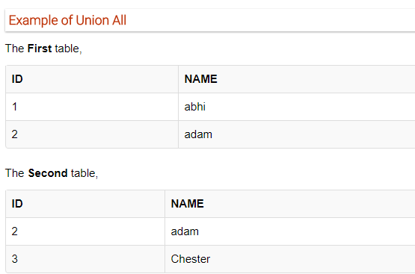
Union ALL
All rows selected by either query, including all duplicates.
Operation is similar to Union. But it also shows the duplicate rows.

Slide 37
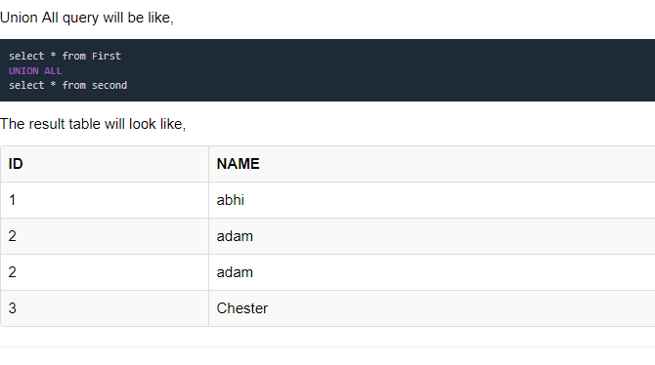

Slide 38
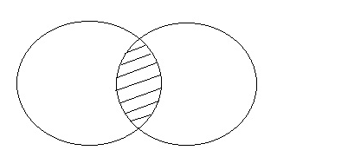
Intersect
All distinct rows selected by both queries.
Intersect operation is used to combine two SELECT statements, but it only returns the records which are common from both SELECT statements.
In case of Intersect the number of columns and data type must be same.
MySQL does not support INTERSECT operator.

Slide 39
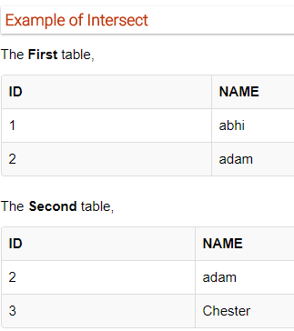
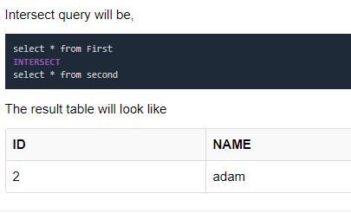

Slide 40

Minus
All distinct rows selected by the first query but not the second.
Minus operation combines result of two Select statements and return only those result which belongs to first set of result.

Slide 41
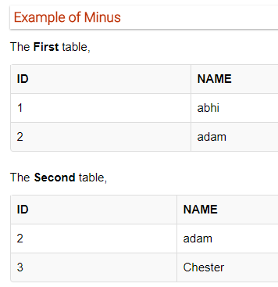
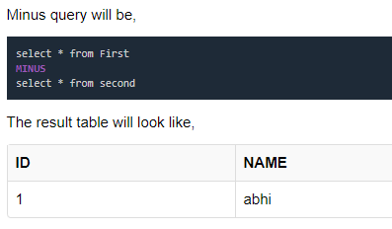

Slide 42
SQL Sequence
Sequence is a feature supported by some database systems to produce unique values on demand.
Some DBMS like MySQL supports AUTO_INCREMENT in place of Sequence.
AUTO_INCREMENT is applied on columns, it automatically increments the column value by 1 each time a new record is entered into the table.
Sequence is also some what similar to AUTO_INCREMENT but its has some extra feature

Slide 43
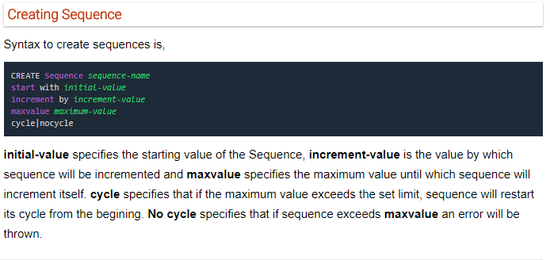

Slide 44
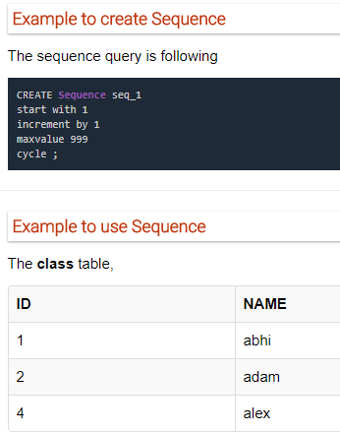
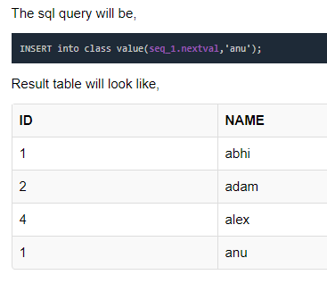
Once you use nextval the sequence will increment even if you don't Insert any record into the table.

Slide 45
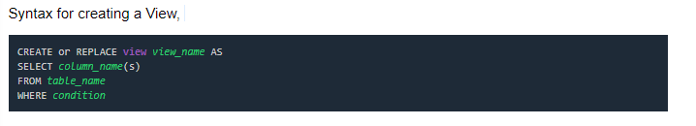
SQL View
A view in SQL is a logical subset of data from one or more tables.
View is used to restrict data access.

Slide 46
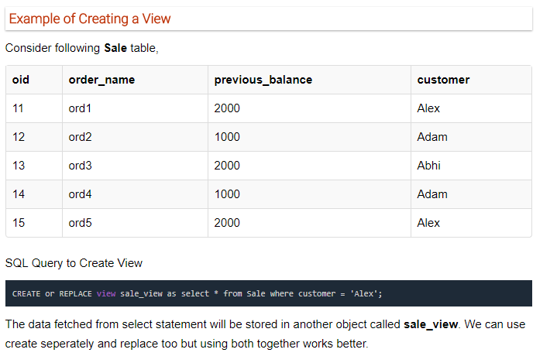

Slide 47
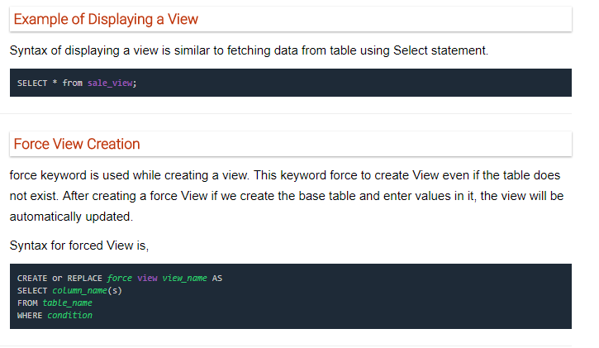

Slide 48
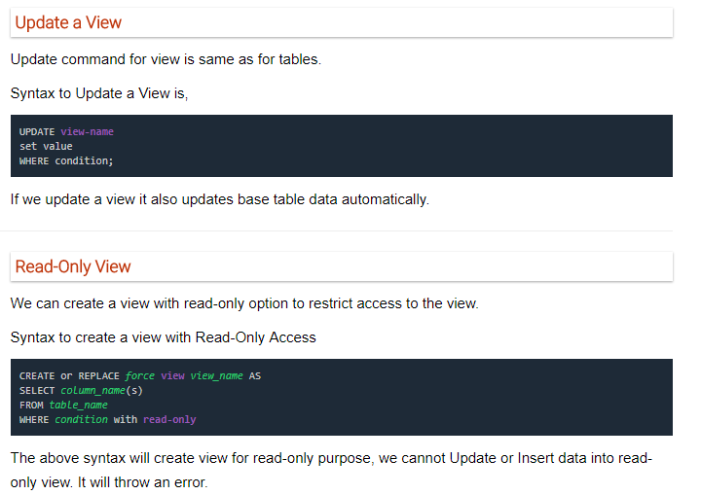

Slide 49
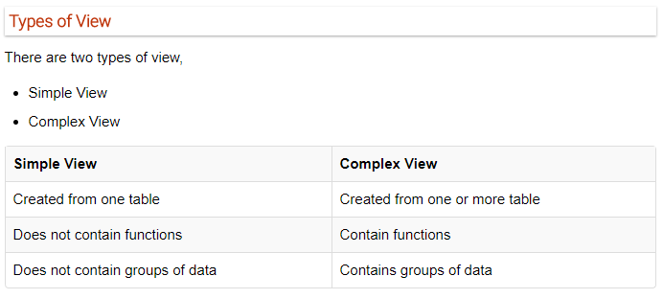

Slide 50
SQl Aggregate Functions
An aggregate function allows you to perform a calculation on a set of values to return a single scalar value.
We often use aggregate functions with the GROUP BY and HAVING clauses of the SELECT statement.
The following are the most commonly used SQL aggregate functions:
AVG – calculates the average of a set of values.
COUNT – counts rows in a specified table or view.
MIN – gets the minimum value in a set of values.
MAX – gets the maximum value in a set of values.
SUM – calculates the sum of values.
Note that all aggregate functions above ignore NULL values except for the COUNT function.

Slide 51
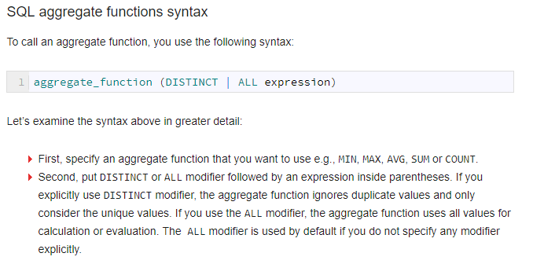

Slide 52
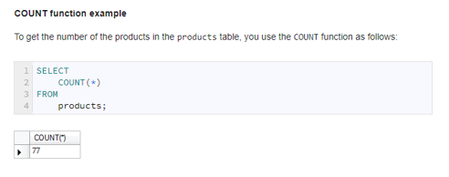
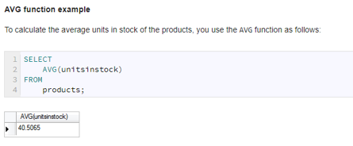
SQL aggregate function examples

Slide 53
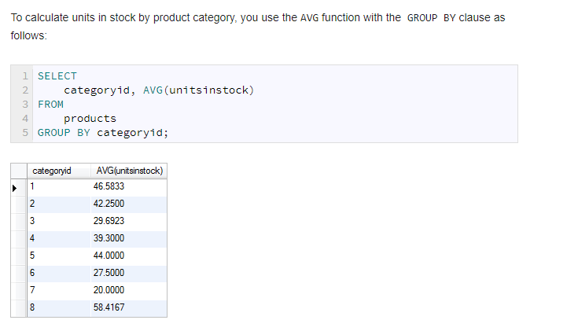

Slide 54
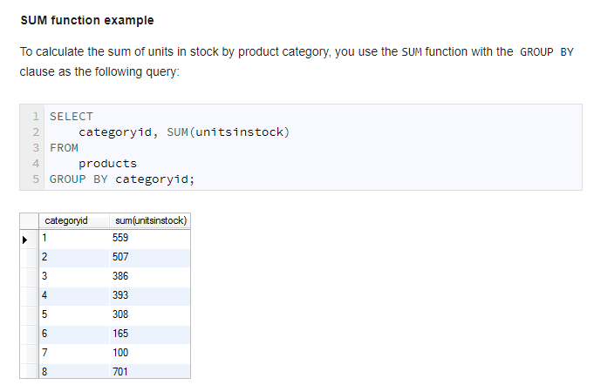

Slide 55
